Slide 1
MIAU Project Tracker
Scope of project

Slide 2
Purpose
The purpose of the project tracker is to give us a way to visually track projects and workload of team members.
It will allow team members to see where resource is available for upcoming projects, and assist them in managing their time.
It produces a summary dashboard to display key statistics and KPIs e.g. how many projects currently have a QA log

Slide 3
Current work
The project tracker in it’s current form was developed by Lizzie Greenwood. It has not been updated since February and contains many out-of-date details.
The app has been created in R-Shiny.
Information can be entered into the app itself or can be entered into a separate database and then read into the app.

Slide 4
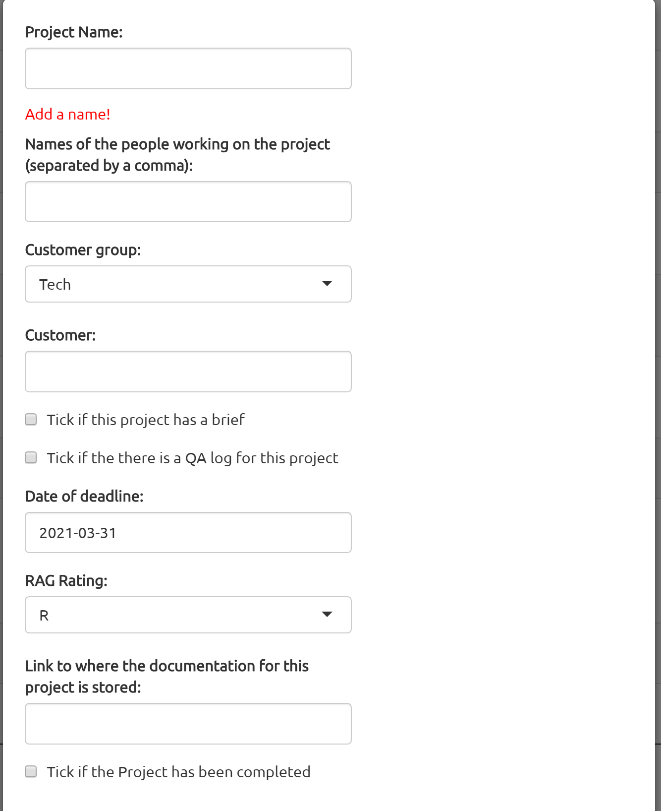
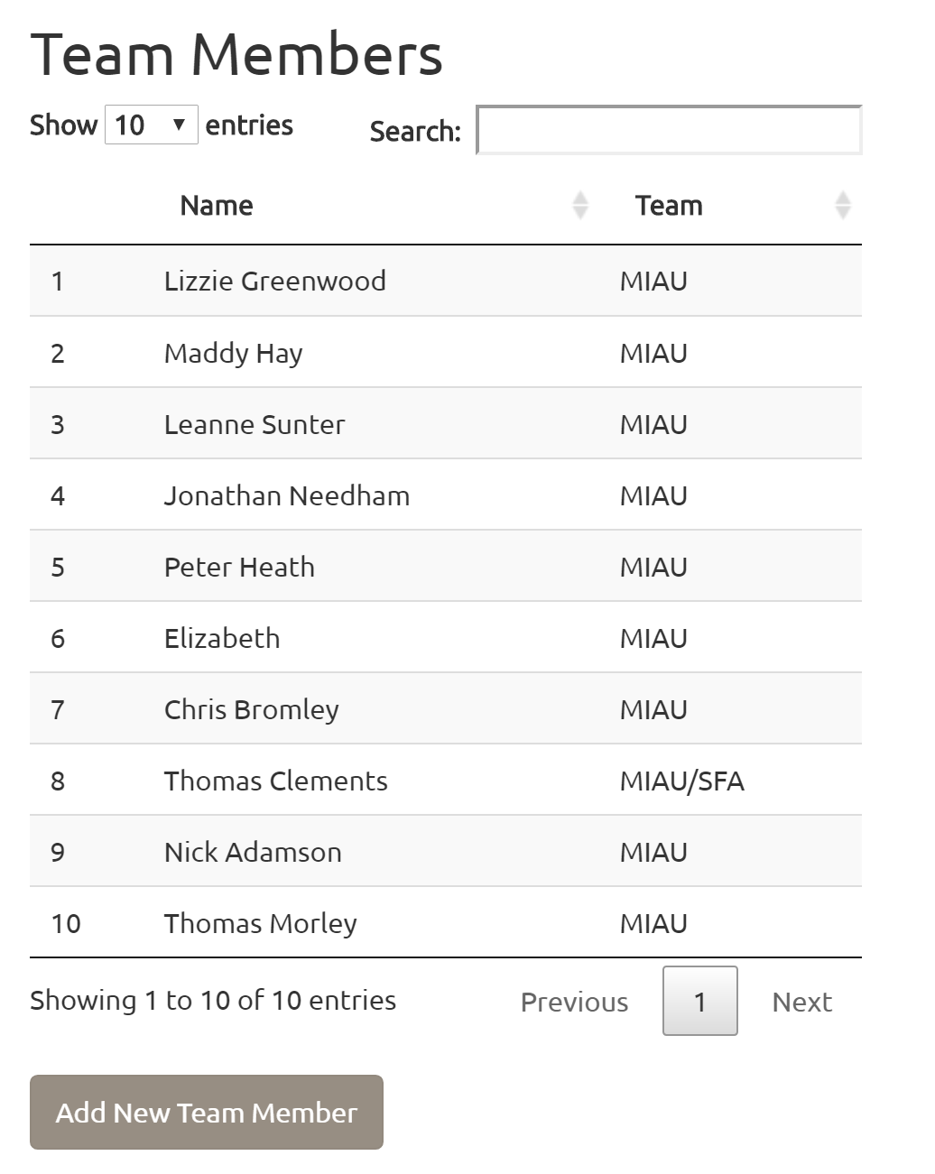
How does it work?
Enter in information about each project, including the people working on the project, the deadline and the RAG rating.
You can also add information about new team members.

Slide 5
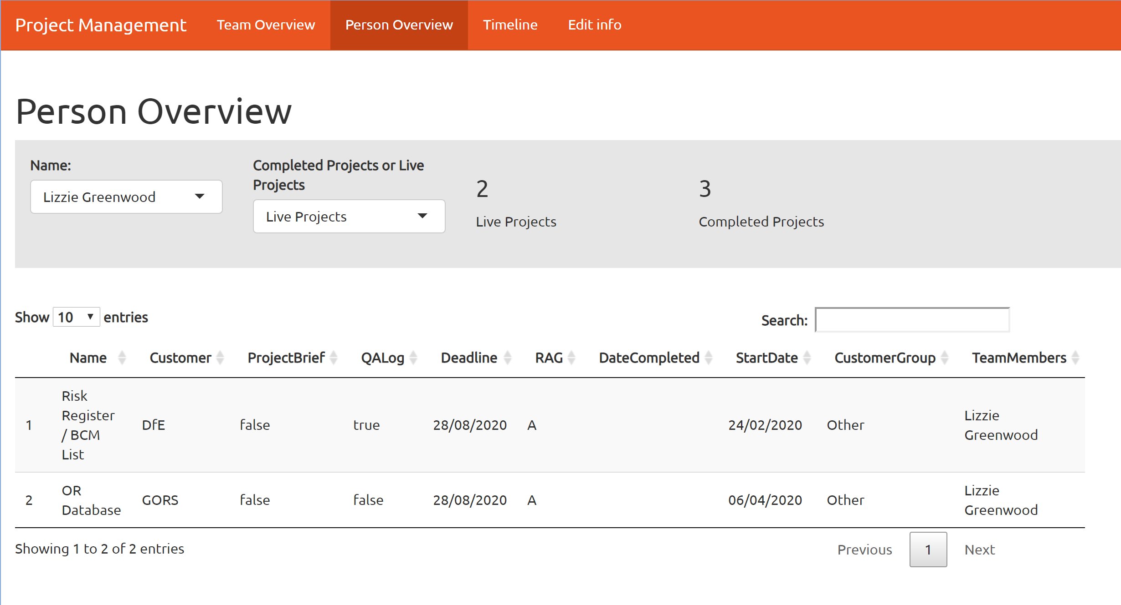
How does it work?
This information is then converted into a number of tables/graphs.
A table that shows what people are working on i.e. select someone’s name and then the projects they are working on are displayed (left empty if currently not working on anything). It is also possible to see previous projects each person has worked on.

Slide 6
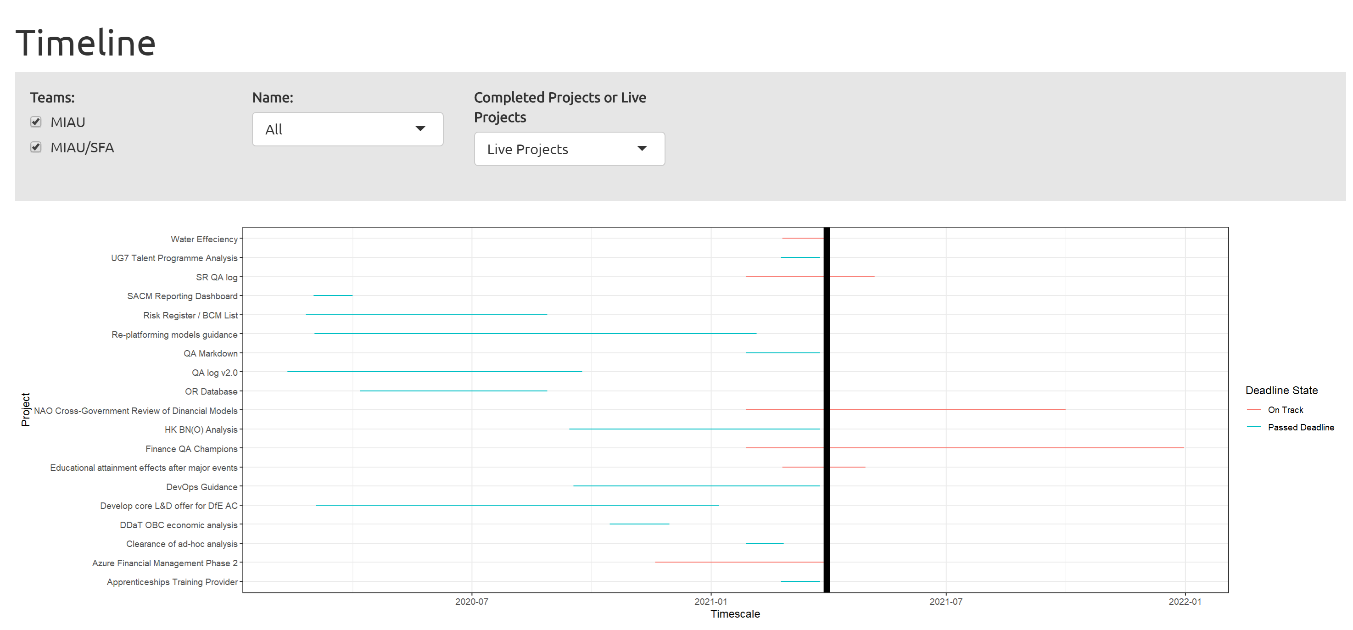
How does it work?
A timeline showing the timescale of different projects, making it easy to view which are live projects, which are upcoming and which are completed.
Selecting “Completed projects” gives you an additional option to control how far back the timeline goes

Slide 7
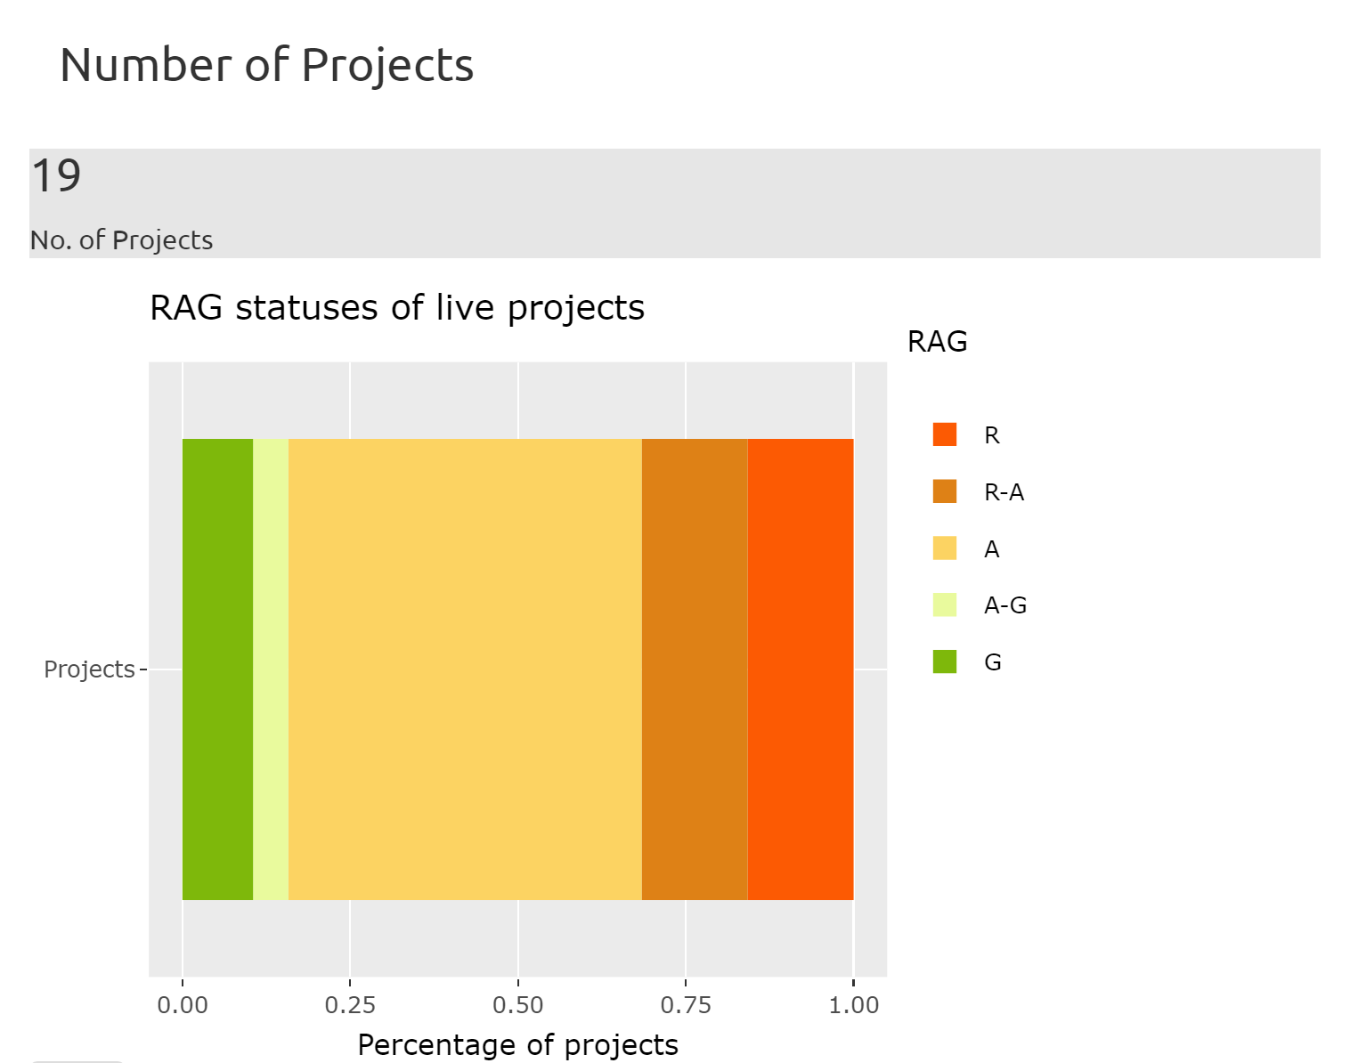
How does it work?
A graph showing percentage of projects sorted by RAG rating and to give a visual overview of how the team is performing as a whole.

Slide 8
Fixes/improvements needed to current model
Some names are overlapping so some changes need to be made with the visuals and the formatting
Currently someone who works across two teams is classed as working in a separate team i.e. Thomas Clements is listed as MIAU/SFA and not as MIAU and SFA. It would be nice to be able to list people as being part of multiple team

Slide 9
Possible other features
Some projects are incomplete and allocated to members who are no longer part of the team. Can we add in a way to flag this?

